Slide 1
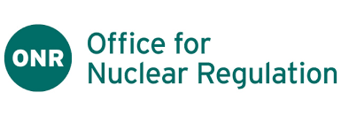
ONR Annual Stakeholder Research
Stakeholder report - 2024
Notes:
Title

Slide 2
Contents
3 | Background and methodology
5 | Executive summary
7 | Overall performance
12 | Innovation in the nuclear industry
15 | ONR and innovation
27 | Artificial Intelligence (AI)
35 | Proportionality and ONR
42 | Conclusions
44 | Contact us

Slide 3
Background
The Office for Nuclear Regulation (ONR) is responsible for regulating nuclear safety, security, safeguards and the transport of radioactive materials, across Great Britain.
ONR commissioned Savanta to undertake its Stakeholder Perceptions Research in 2024. The aim of this research is to explore in depth:
Attitudes to innovation in the nuclear industry;
Perceptions of ONR and their approach to innovation in the nuclear industry;
Perceptions of the impact of Artificial Intelligence (AI) in the nuclear industry and ONR’s approach to this;
The levels of proportionality in ONR operations and performance.
This research was focused on speaking to representatives from site licensees and those who work on licensed and authorised sites. A sample of other dutyholders regulated by ONR were also invited to participate in this research.

Slide 4
Methodology
Sample breakdown
Type of site | Number of responses
Defence site (weapons) | 5
Defence site (propulsion) | 23
Decommissioning site | 75
Fuel manufacture site | 3
MOD Authorised site | 3
Waste treatment and disposal site | 9
Operating Civil Reactor site | 20
New Reactor Construction site | 8
Dutyholder (not a licensee or authorised site) | 2
Transport dutyholder | 3
ONR stakeholders were surveyed online between 16th February and 27th March 2024.
151 respondents took part from a database of 906 contacts, although respondents were invited to share the survey with other members of their team/organisation.
As this survey was targeted at specific groups and on specific topics, this does not offer comparisons to previous waves of data, instead presenting a snapshot of opinion at this point in time.
Alongside this survey, participants who consented were invited to take part in an in-depth interview to further explore their attitudes and perceptions in more detail. In total 15 interviews were conducted, and their responses are analysed alongside the data from the survey to build a complete picture of attitudes of the nuclear sector.
Status of site | Number of responses
Authorised site | 3
Licensee | 143
Other dutyholder | 2
Transport dutyholder | 3

Slide 5
Executive summary

Slide 6
Headline findings
Overall performance
Four in five (79%) stakeholders agree that ONR operate in a way that is consistent, whilst nine in ten (93%) agree that ONR delivers on its mission to 'To protect society by securing safe nuclear operations’.
Innovation
For many stakeholders innovation is important as a way of reducing risk to humans working in the nuclear industry, but there are potential challenges in an industry that has such high levels of risk.
Just over half of stakeholders (52%) had contacted ONR to enquire about innovation. More than two-thirds (68%) of those who have approached ONR agree ONR has enabled the adoption of innovation in industry.
Two-thirds of stakeholders feel ONR is effective at promoting stakeholder networks to develop innovative approaches (66%), whilst a similar number (65%) agree ONR provides a stable, yet progressive, regulatory environment that enables the delivery of cost-effective safety, security and safeguards.
Whilst most stakeholders feel that ONR are supportive of and open to innovation, ONR are perceived to generally be more reactive rather than proactive.
Artificial Intelligence (AI)
One in 10 (13%) stakeholders have used AI so far, however more than two-thirds (70%) of stakeholders agree that AI will become more relevant to the nuclear industry as it develops.
There is a degree of uncertainty regarding ONR’s attitude to AI, only one in ten (13%) being aware of ONR’s approach to AI to at least some extent.
Proportionality
Three-quarters (72%) of stakeholders agree ONR act in a way that is proportionate, although there is evidence that this can still vary by site depending on the inspectors or contacts.
Four in five (80%) agree ONR applies a proportionate approach when implementing safety and security regulations.

Slide 7
Overall performance

Slide 8
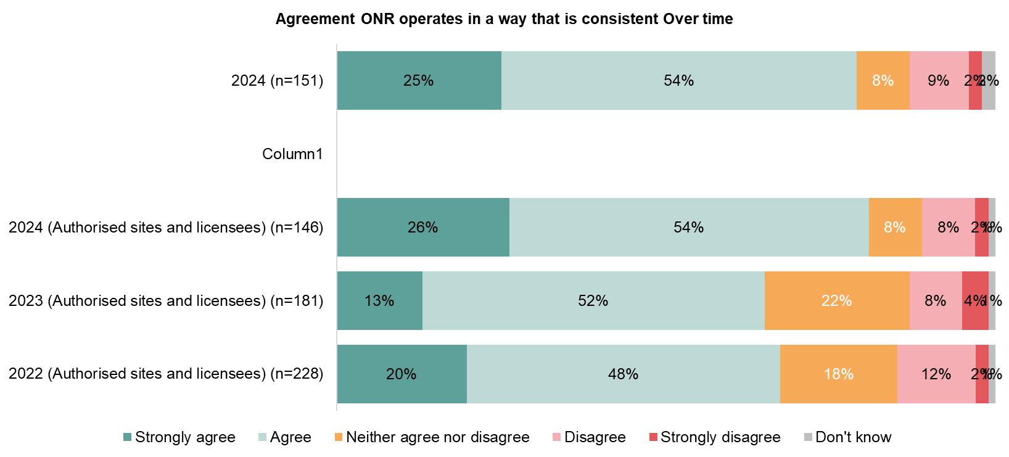
For the most recent survey four in five stakeholders agreed that ONR operates in a way that is consistent
Amongst authorised sites and licenses this was up by 15 percentage points since 2023, with most of the change being driven by stakeholders being less likely to say their neither agree nor disagree, with this falling by 14 percentage points since 2023 and eleven percentage points since 2022. However, this sample was notably smaller and used stakeholders own networks to share the survey.
NET Agree
NET Disagree
79%
11%
80%
10%
65%
13%
68%
14%
Q1. To what extent, if at all, do you agree or disagree that ONR operates in a way that is consistent?

Slide 9
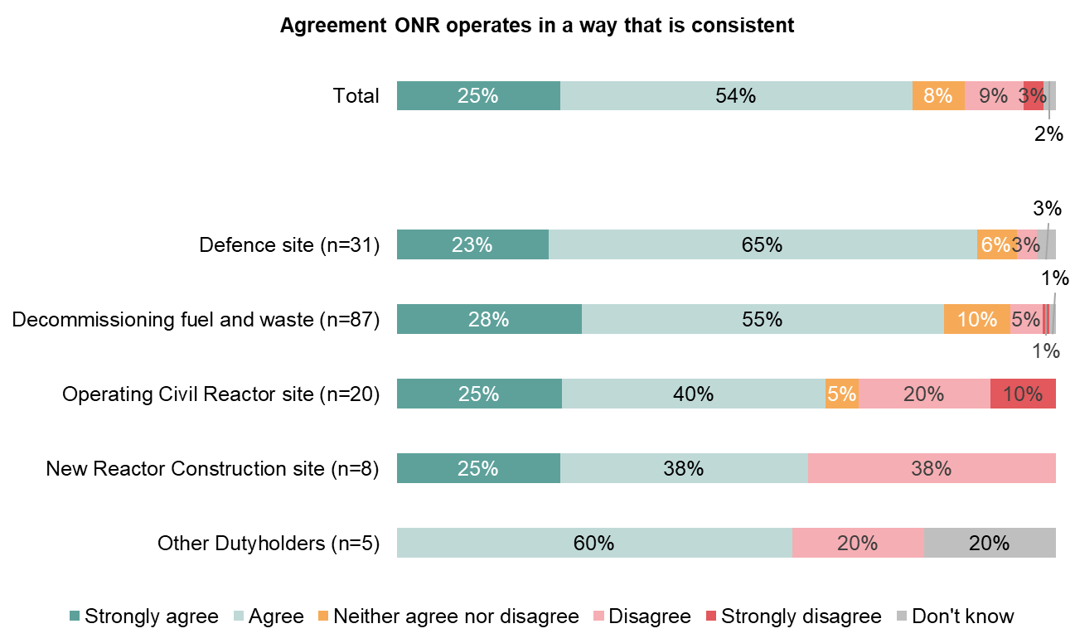
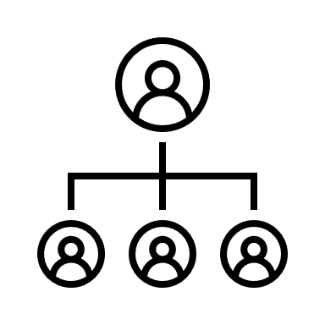
More than three-quarters of stakeholders feel ONR operates in a way that is consistent
This was broadly similar amongst representatives from all organisations, however those working in defence sites in particular considered ONR to be consistent in their operations.
NET Agree
NET Disagree
Agreement ONR is consistent - by level
79%
11%
Director level
85%
87%
3%
Manager / Supervisor
76%
83%
6%
Junior operative 100%
65%
30%
63%
38%
60%
20%
Q1. To what extent, if at all, do you agree or disagree that ONR operates in a way that is consistent? (n=151)

Slide 10
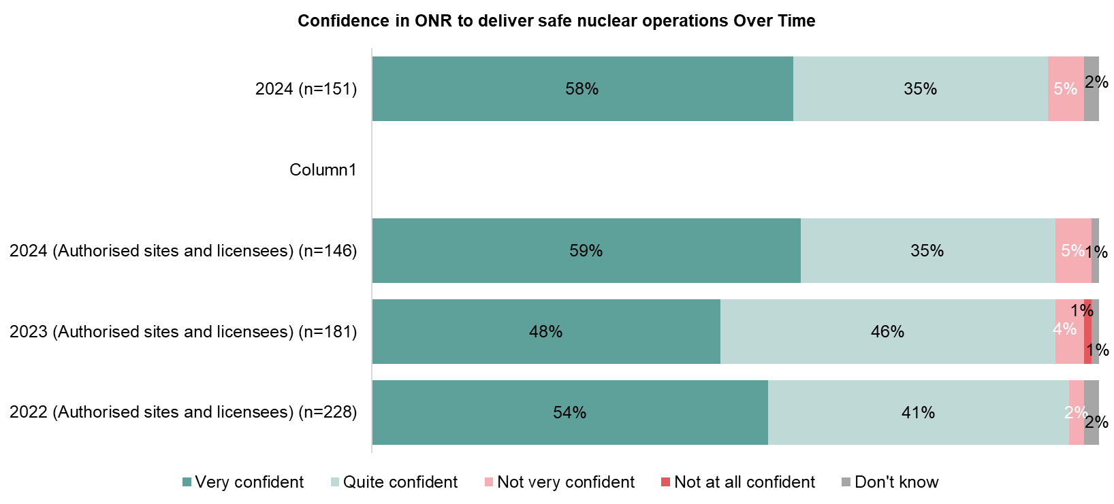
The confidence in ONR delivering on its mission to protect society by securing safe nuclear operations has remained high
Despite a change in the overall sample and approach this figure has remained high since 2022, although there is a relative increase in those being very confident in ONR delivering on its mission, up ten percentage points since 2023.
NET Confident
NET
Not confident
93%
5%
94%
5%
94%
6%
95%
3%
Q2. ONR's mission is 'To protect society by securing safe nuclear operations.' How confident or not are you that ONR is delivering this?

Slide 11
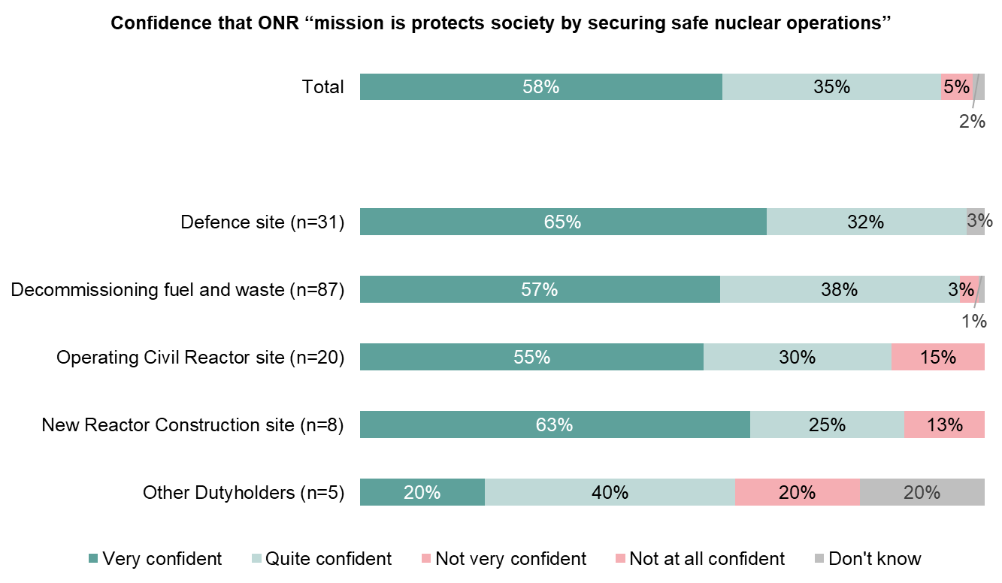
Whilst more than nine in ten feel confident that ONR protects society by securing safe nuclear operations
This was similar across all types of sites, with all sites being generally confident ONR does achieve its mission. This was particularly the case at the most senior levels with almost all Director-level stakeholders feeling confident ONR does achieve its core mission.
NET Confident
NET
Not
Confident
Confidence in ONR delivers its mission - by level
93%
5%
Director level 98%
97%
0%
Manager / Supervisor
93%
95%
3%
Junior operative 83%
85%
15%
88%
13%
60%
20%
Q2. ONR's mission is 'To protect society by securing safe nuclear operations.' How confident or not are you that ONR is delivering this? (n=151)

Slide 12
Innovation in the nuclear sector

Slide 13
For many in the nuclear industry, innovation is seen as an opportunity to reduce risk, particularly in the process of decommissioning and waste management
Stakeholders working at decommissioning or waste management sites feel that innovation primarily relates to new technologies that can help decrease risks to individuals working in the nuclear industry.
However, those who work at energy generation sties tend to see innovation as a potential way to speed up and improve processes, either via reducing time through efficient working practices, or with the help of new technology.
“I would say it's the application of new technologies, for me, and that could be new technologies full stop, so developing something specific for addressing hazard and risk reduction.”
Decommissioning Site
“I suppose, it's using the latest technology, that can have a big bearing on the way you do decommissioning and work like that. If something new comes in that wasn't available 20 years ago, you're going to look at different ways to do it.”
Decommissioning Site
“Innovation would be achieving the required outcomes in a more efficient way. Embracing be it new technologies, different ways of working or whatever it is.”
Operating Civil Reactor Site
These often involve small and simple steps to improve the speed at which repairs and tests are carried out.
Various examples are cited including use of drones and robotics to check areas where there may be a physical risk to individual safety, either via radiation or just traditional health and safety concerns.
“We were able to design ourselves a little complex next to our office, so that the team leader could pop in and check the alarms. So rather than having to have a technician sat there all the time waiting for the alarms, the technician has a phone direct to the team leader.”
Operating Civil Reactor Site
“Historically we've manufactured all our own gaskets by cutting them out of gasket material. But actually, in modern facilities, you use a gasket cutting machine that does that for you.”
Operating Civil Reactor Site
“So, innovation that we see […] various remote devices, so the likes of drones, both in the air and in the water.”
Defence Site
“In the past, you'd be talking building scaffolds and everything and going up on the roof. Now you can get a drone that can give you the same quality of checks.”
Defence Site
What does innovation in the context of the nuclear industry mean to you? (Qual interviews)
Have you got some examples of innovative methods that have been used (Qual interviews)

Slide 14
Perceptions of the dangers of nuclear material and the importance of safety and security in operations are key concerns
For many Stakeholders, it is an industry wide challenge and that the high-risk nature of materials and work that make innovation challenging. They feel that there may be simple opportunities to be innovative, but being able to test in real-life situations with high-risk materials is an additional barrier.
“Again, just my opinion, carrying out enough tests inactively to be sure it will work when you put it into an active environment. Also, that the radiation won't have an effect on whatever technology you're potentially going to introduce into a very harsh environment.“
Decommissioning Site
“I think what it depends on is how dramatic the innovation you're taking, because the conferences are so dramatic, I think some of the easier stuff is where the innovation can flourish, and I think the complex stuff is complex for a reason.”
Defence site
“The main barriers are people really don't understand the significance of radiation... And so, there is a perception, even within the nuclear industry, even within people who work in it, that it's more dangerous than it actually is."
Decommissioning Site
Other barriers include the regulatory framework and availability of clear guidance and examples that will allow innovation to take place with a degree of confidence.
“It would be really good to see some clear guidance and assistance and help in how we use some of the newer products that are being introduced through, just through natural innovation of, like, natural technological progression and innovation. Particularly, in general, and certainly my experience is that we struggle in the nuclear industry to utilise software and firmware.”
Defence site
“It's the homogenous nature of ONR, CNSS, the nuclear safety safeguards again. [There is] a complete lack of understanding and appreciation of the duty holder's perspective. […] given the subjective nature of the ONR, and how they carry themselves, we could invest enormously into something that is fine today but tomorrow is completely not.”
Operating Civil Reactor Site
“And the way licensing and that works, it forces you to look at what innovation it is you're bringing through, and if something is new and innovative. I can't remember the words used, but we have specific questions we ask ourselves and the regulators will ask us, and that's, 'How much risk is involved?”
Decommissioning Site
What do you think are the main barriers to being innovative in the Nuclear Industry (Qual interviews)
Where do you see the future of innovation in the nuclear industry(Qual interviews)

Slide 15
ONR and innovation

Slide 16
Summary: ONR and innovation
Just over half of stakeholders (52%) had contacted ONR to enquire about innovation. This was particularly common amongst senior decision makers (60%).
Most stakeholders would initially engage with someone they speak to in person, for example inspectors (84%). This is often seen as an effective method by stakeholders, who feel they can approach someone they know who will point them in the right direction and highlight any issues.
ONR is generally seen to be effective at promoting stakeholder networks to develop innovative approaches (66%), whilst a similar number (65%) agree ONR provides a stable, yet progressive, regulatory environment that enables the delivery of cost-effective safety, security and safeguards.
In previous stakeholder surveys, a third (34%) of Licensees have said ONR enables innovation across the nuclear industry. This was not asked in this survey, but just under half of stakeholders agree that ONR plays an impactful role in supporting industry to realise the benefits of new technology and novel approaches suggesting that amongst licensees there is more confidence in ONR enabling innovation.
The majority of stakeholders are aware of and know at least a bit about the provision of regulatory advice (82%), however stakeholders are somewhat less aware of other measures ONR take to support innovation. Less than half (41%) are aware and know at least a bit about formal engagements with ONR.
“I'd approach, [the inspector] to direct me to the right people.” Decommissioning site
“I would say they are because they set themselves up to be responsive” Decommissioning site

Slide 17
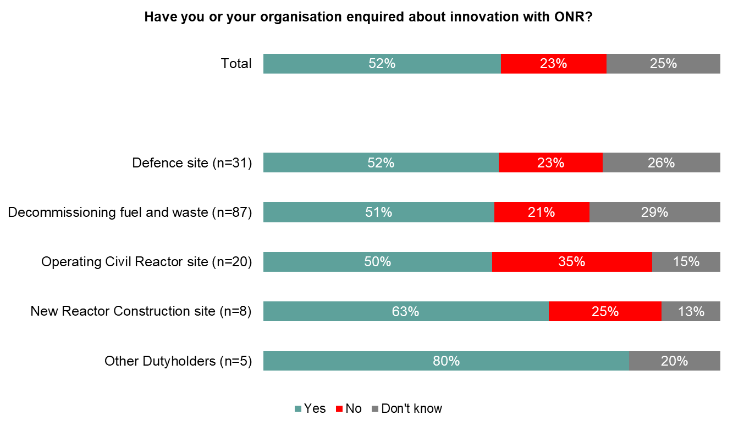
Over half of stakeholder’s organisations have enquired about innovation with ONR
Those working in New Reactor construction sites are most likely to contact ONR, as well as those who are in the most senior roles.
Director level
60%
Manager / Supervisor 43%
Junior operative 50%
Q3. Have you or your organisation enquired about innovation with ONR? (e.g. communicating with inspectors, visiting the ONR website etc.) (n=151)

Slide 18
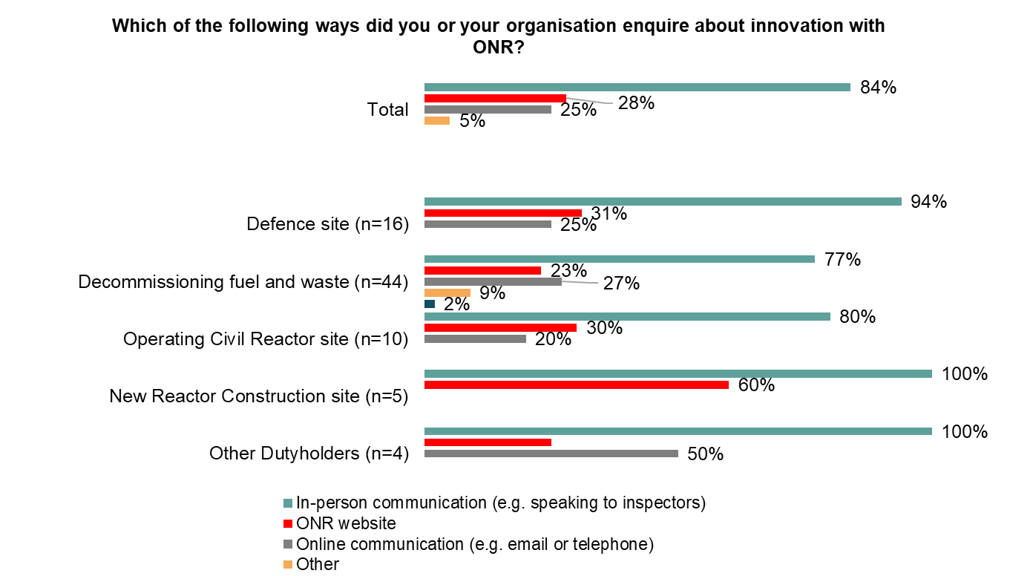
The most common way stakeholders contact ONR is through their already established contacts such as inspectors
When explored further, the primary contact could often vary depending on role, with safety directors likely to have direct contacts at ONR with whom they would discuss innovative approaches. The first port of call for most stakeholders was still a contact they worked closely with already and trusting them to direct their enquires to the most relevant person.
“I'd approach, [inspector] to direct me to the right people.” Decommissioning site
“I would expect to speak to my opposite number within ONR and discuss it through. And depending on how innovative it is, it's how protracted those discussions might be.”
Defence site
“They do talk about it at the safety director's forum which I mentioned which is a cross-industry working group.”
Decommissioning site
Q4. Which of the following ways did you or your organisation enquire about innovation with ONR?(n=79)
Who would you approach to discuss a new innovative approach with ONR (Qual interviews)

Slide 19
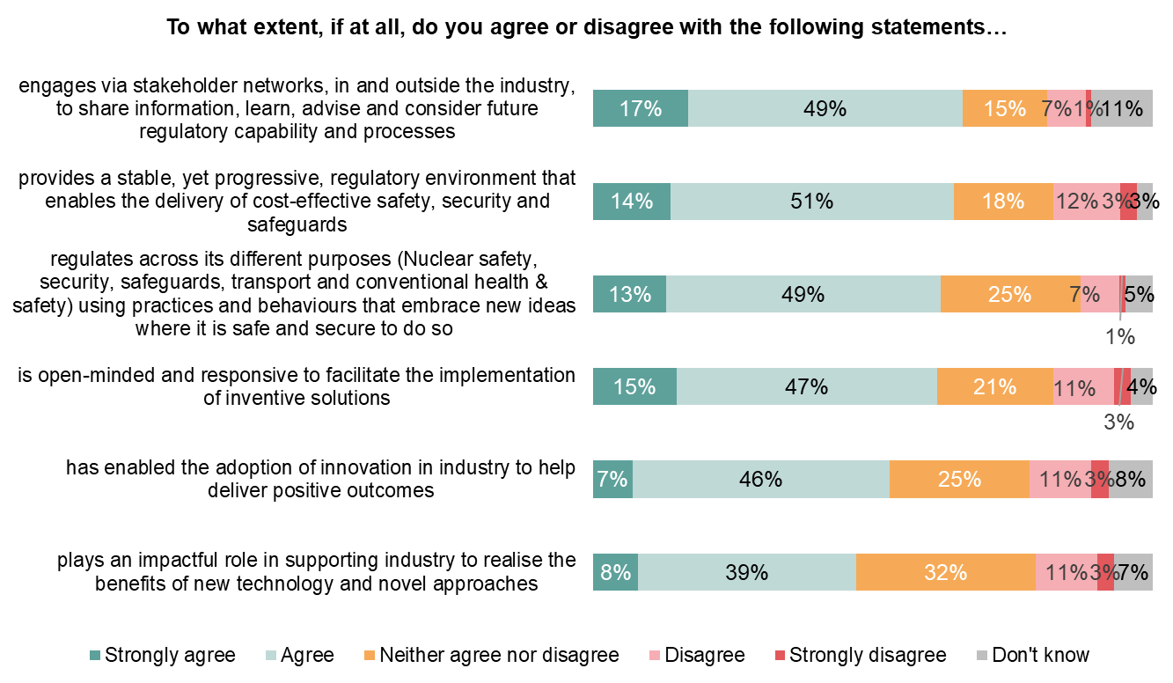
ONR is generally seen to be effective at promoting stakeholder networks to develop innovative approaches
More than two-thirds (68%) of those who have approached ONR to enquire about innovation agree ONR has enabled the adoption of innovation in industry to help deliver positive outcomes, compared to under a third (29%) of those who have not enquired about innovation.
NET Agree
NET Disagree
Stakeholder type
Stakeholders from Operating Civil Reactor sites and New Reactor Construction sties tend to be the least likely to agree with any of the statements.
Only four in ten (40%) Stakeholders form Operating Civil Reactor sites agree that ONR are “open-minded”.
This contrasts particularly with Decommissioning and fuel waste sites and Defence sites where over two-thirds (70% and 65%) agree that ONR are “open-minded”.
66%
8%
65%
15%
62%
8%
62%
14%
53%
15%
47%
14%
Q5. To what extent, if at all, do you agree or disagree with the following statements about ONR's approach to innovation? ONR..(n=151)

Slide 20
The Nuclear sector is broadly considered to be conservative in nature, due to the high levels of risk involved with the materials they work with
Stakeholders have slightly differing views on the extent to which ONR supports innovation, many who have close working relationships with ONR feel that they do support innovation, however there are some suggestions that ONR could do more to support sites being innovative.
Broadly across all kinds of sites stakeholders appreciate ONR’s work and feel they do have a supportive approach. The main way stakeholders interact with ONR remains through inspectors so that they will often discuss approaches with them, or their other contacts at ONR, before making a formal request.
Where there is concern, is that this may not be clearly promoted by ONR. Stakeholders often use an established relationship to approach ONR, but it may seem that ONR are not proactive in setting out their expectations regarding innovation in the nuclear sector.
“The guys that I have been involved with in terms of the inspectors, etc., have been very open on support and offering advice when I've been involved, and certainly the feedback I've had from my immediate colleagues that do work with them on a regular basis is that they're very open to supporting in these realms”
Defence site
“I wouldn't say that they have a very visible business plan which says, 'We intend to innovate', so that people like me can see what they're really up to and, I suspect equally so, individual inspectors within the ONR see what they're up to because there's an apparent not following the herd behaviour.”
Decommissioning site
“I would say, yes [they promote early access to regulatory advice]. However, there's a but, and that but is I don't think we as an industry want to ask that many times.”
Decommissioning site
“Because we have a good relationship with the site inspector, […] I think we can have a lot of that communication […]so before that paper lands on somebody's desk, you've got an idea whether it's going to be acceptable or not, or if you need to tweak it or not..”
Operating Civil Reactor site
"Superficially they will fulfil that. So, if you were a person who perhaps wasn't particularly well informed, I imagine you'd be able to look and there would be some kind of regulatory guidance […] if you scratch beneath the very thin veneer, you would find that the language that is used will be watered down”
Decommissioning site
How would you describe ONR in terms of their approach to innovation? (Qual interviews)
ONR aims to promote early access to regulatory advice in the design of innovative solutions. Do you think ONR fulfils this ambition (Qual interviews)

Slide 21
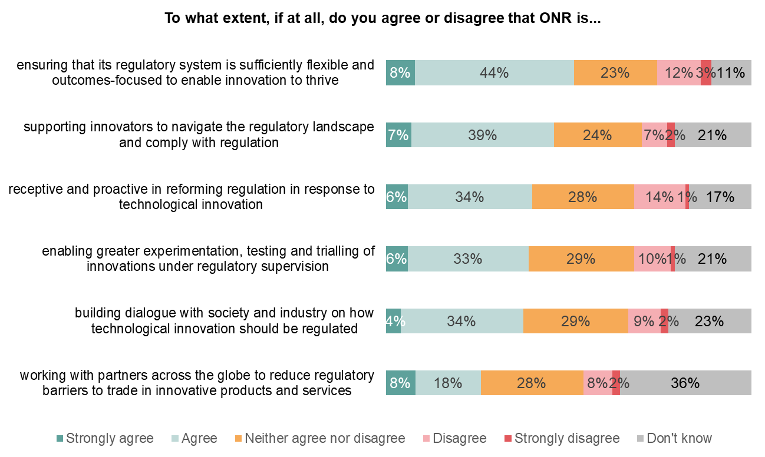
Just over half of stakeholders agree ONR ensures its regulatory outcome is flexible enough to allow for innovation, but there is also some uncertainty about the extent to which this is true
This significantly increases amongst stakeholders who have reached out to discuss innovation who are consistently more likely to agree with the statements. This, combined with the high level of uncertainty around the extent to which ONR builds dialogue with industry, suggests there may be a perception challenge.
NET Agree
NET Disagree
By Stakeholder type
Stakeholders from Defence sites were particularly likely to agree that ONR ensures its regulatory system is sufficiently flexible. Almost two thirds (65%) agree with this statement, compared to under half of stakeholders from Decommissioning fuel and waste sites (48%) and Operating civil reactor sites (40%).
However, stakeholders from Decommissioning fuel and waste sites were statistically more likely to agree that ONR enables greater experimentation (51%) than Defence sites (23%).
52%
15%
46%
9%
40%
15%
39%
11%
38%
11%
26%
10%
Q6. To what extent, if at all, do you agree or disagree that ONR is... (n=151)

Slide 22
More than four in five stakeholders are aware of the provision of regulatory advice, however under half are aware of formal engagements with ONR
Provision of regulatory advice from ONR is particularly effective for stakeholders, as more than three-quarters (77%) of those who had heard of that approach found it helpful. More formal engagements are still effective, but less commonly used by stakeholders.
NET:
Know at least a bit about it
82%
54%
41%
NET:
Effective
77%
63%
56%
Q8. To what extent are you aware of the following ONR approaches to regulating innovation (n=151)
Q9: To what extent is ONR effective at managing the following approaches to regulating innovation?

Slide 23
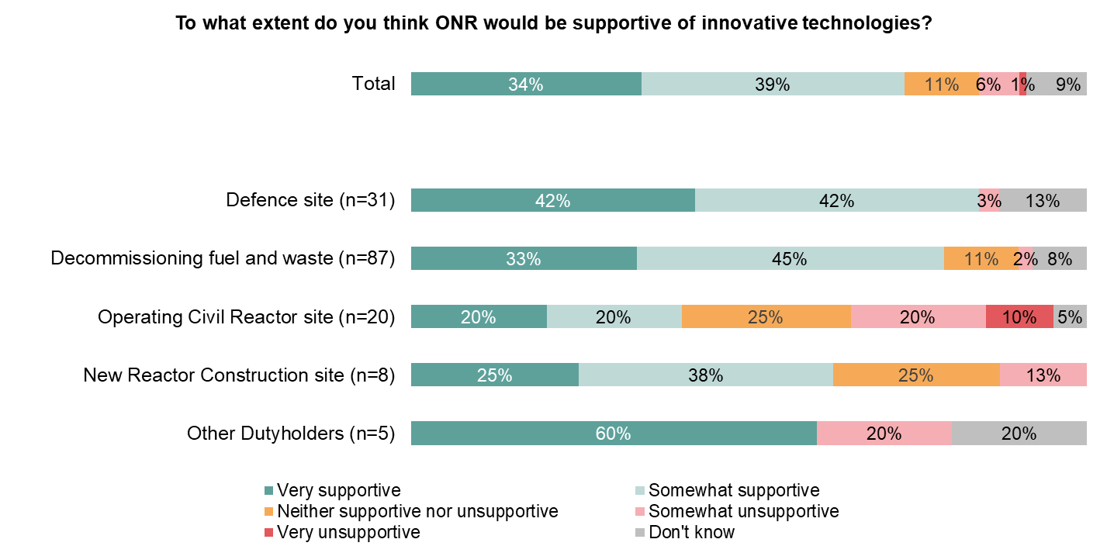
Almost three-quarters of stakeholders think ONR would be supportive of new innovative technologies, with stakeholders from Defence sites most likely to feel ONR would be supportive
Overall, eight of ten (80%) of those who have enquired about innovation say they think ONR would be supportive of innovative technologies. Those who have not had direct experience of working with ONR on innovation seem to be less confident that ONR would respond supportively (59%).
NET Supportive
NET Unsupportive
73%
7%
84%
3%
78%
2%
40%
30%
63%
13%
60%
20%
Q11. If you or your organisation wanted to explore innovative technologies, to what extent do you think ONR would be supportive of this? (151)

Slide 24
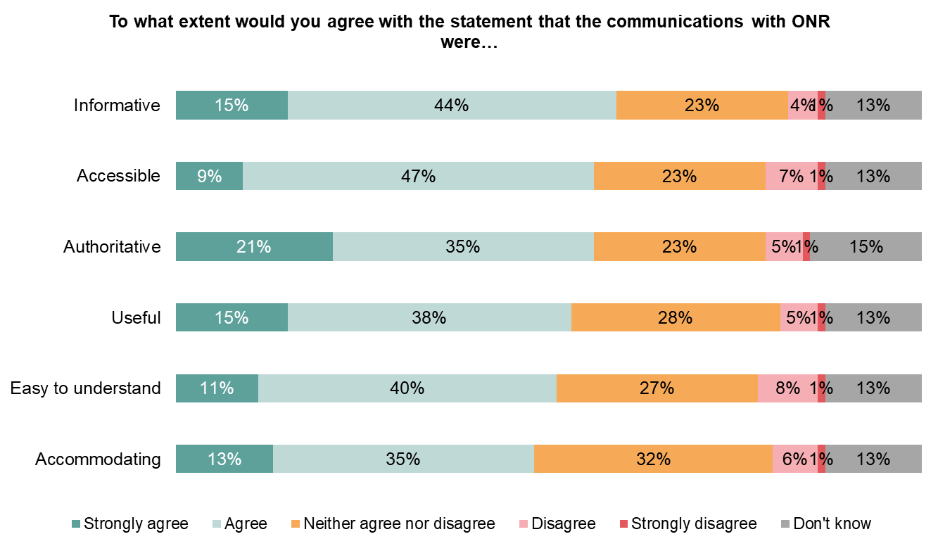
Whilst a majority do see ONR as informative and accessible, there is a less confidence that ONR are accommodating
Under half (48%) of stakeholders agree ONR is accommodating, with stakeholders from Operating Civil Reactor Sites particularly unlikely to agree with only a third (35%) of these stakeholders agreeing compared to nearly two-thirds (61%) of stakeholders from Defence Sites.
NET Agree
NET Disagree
By Stakeholder type
Stakeholders from Defence sites were more likely to agree with all statements, in particular about communications from ONR being informative. Almost three-quarters (71%) agree that ONR communications are informative. This compared to stakeholders from New Reactor Construction sites where only a third (38%) agreed.
58%
5%
56%
8%
56%
6%
53%
5%
50%
9%
48%
7%
Q12. Thinking about how ONR communicates with you or your organisation regarding innovation, to what extent would you agree with the statement that the communications were: (n=151)

Slide 25
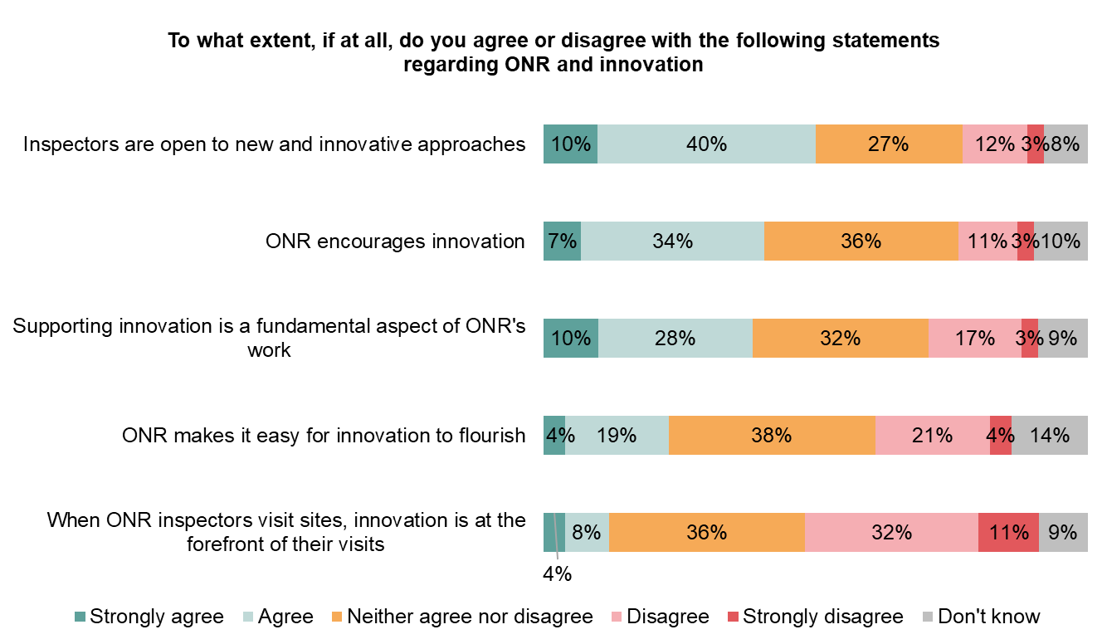
Whilst most stakeholders feel that ONR are open to innovation, ONR are perceived to generally be more reactive rather than proactive
Most stakeholders agree inspectors are open to innovative approaches, particularly amongst those who have enquired about innovation (58% vs 29%). However, amongst all stakeholders, they are more likely to say that they disagree that ONR inspectors have innovation at the forefront of their visits.
NET Agree
NET Disagree
Stakeholder type
There were no clear differences between different types of sites noted.
Directors and Senior leaders / heads of department were more likely than Mangers / supervisors to agree that ONR inspectors are open to new and innovative approaches, (60% vs 39%). This suggests that discussions with ONR about innovation still tend to take place more often at a strategic level.
50%
15%
41%
13%
38%
20%
23%
25%
12%
44%
Q13. To what extent, if at all, do you agree or disagree with the following statements regarding ONR and innovation (n=151)

Slide 26
Where stakeholders have worked closely with inspectors, they have found them open to innovation, but most commonly in response to what is proposed
Working closely with inspectors increases the likelihood stakeholders will say they are open to innovation, and despite some contrasting experiences for some, on the whole stakeholders felt inspectors were supportive of innovation. However, there is a sense the innovative ideas broadly come because sites approach ONR.
“The guys that I have been involved with in terms of the inspectors, etc., have been very open on support and offering advice when I've been involved, and certainly the feedback I've had from my immediate colleagues that do work with them on a regular basis is that they're very open to supporting in these realms.”
Defence site
“Yes. And again, as part of their mantra of enabling regulator, they have offered up some learning, previous contracts, previous projects and also interactions with other site licensees to help with our project delivery."
Decommissioning site
“So, there are some individuals who are fairly positive about looking for improvements, innovation, but there are a lot of other individuals who are incredibly resistant of innovation, at corporate level.”
Decommissioning site
“It's that proactiveness to it. Not just ‘I'm responsive’"
Decommissioning site
To help support the nuclear industry in being more innovate, stakeholders feel that ONR could do more in terms of setting out a clear roadmap of what they believe innovation could look like, and by sharing knowledge of innovative approaches that have been used elsewhere.
“Doing a lot more on comms. That would be an easy thing to do, put out a flyer to the site managers, site directors and say, 'This is some of the innovation we've been looking at and we're supportive of’”
Defence Site
"I mean, knowledge sharing should be there, it should be better than it is. ONR is a smaller group, so they should be able to share internally anything that's coming up and then pass it out wider to the various sites’”
Decommissioning site
“I wouldn't say that they have a very visible business plan which says, 'We intend to innovate', so that people like me can see what they're really up to and I suspect equally so individual inspectors within the ONR.”
Decommissioning site
Are ONR inspectors open to innovation? (Qual interviews)
What else do you think ONR could be doing to promote innovation (Qual interviews)

Slide 27
Artificial Intelligence (AI)

Slide 28
Summary: Artificial Intelligence (AI)
AI is still somewhat of an unknown quantity for stakeholders with just over one in 10 (13%) having used AI to date. However it is recognised as a growing topic with more than two-thirds (70%) of stakeholders agreeing that AI is a tool that will become more relevant to the nuclear industry as it develops.
Reflecting this, there was a level of uncertainty regarding ONR’s attitude to AI, with only one in ten (13%) being aware of ONR’s approach to AI in the nuclear industry, though it was expected they would have a position.
Under one in ten stakeholders (8%) agree that ONR clearly articulates the benefits of AI and a similar number (9%) feel ONR actively encourage AI innovation. This is lower than the proportions of stakeholders who feel ONR encourage innovation generally.
Use of AI is likely limited whilst stakeholders aim to understand how it could be used and what the regulatory framework would look like.
“Well, I couldn't give a definitive answer to the question, but I would be surprised if they're not exploring it to see what their role could be in implementing it, if there is a place for it.”
Decommissioning site
“No we wouldn’t use AI until there was some kind of regulatory guidance.”
Operating Civil Reactor Site

Slide 29
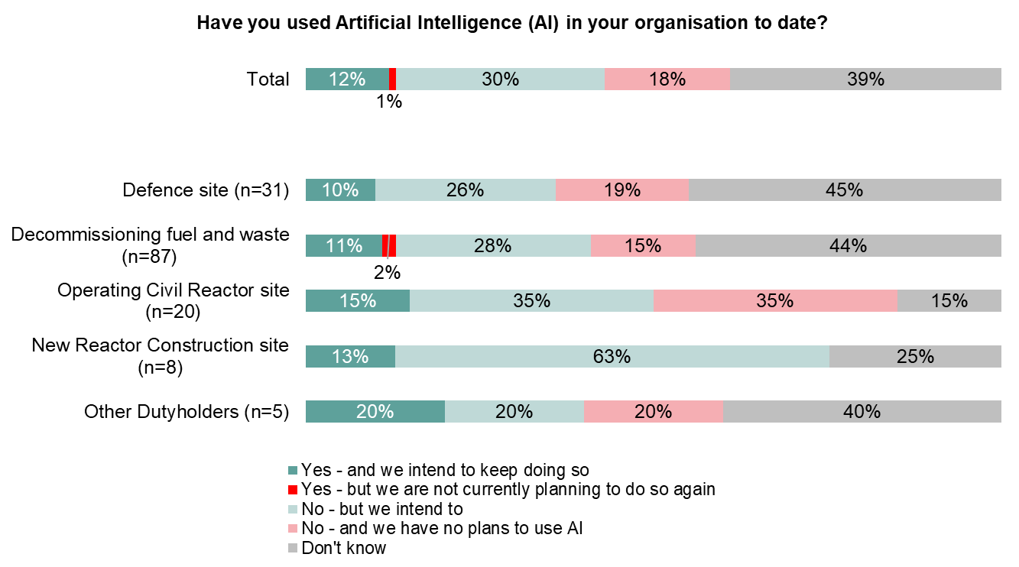
AI is still only very limited in it’s use in the nuclear sector, with just over one in 10 (13%) being sure they have used AI to date
However, there is a sense that AI will be a future issue that the nuclear industry will have to adapt to, with over two in five (42%) intending to use AI in the future. In particular, stakeholders working in New Reactor Construction Sites were unanimous in expecting to use AI in the future.
Use of AI - by level
Director level
17%
Manager / Supervisor 6%
Junior operative 33%
Q14. Have you used Artificial Intelligence (AI) in your organisation to date?

Slide 30
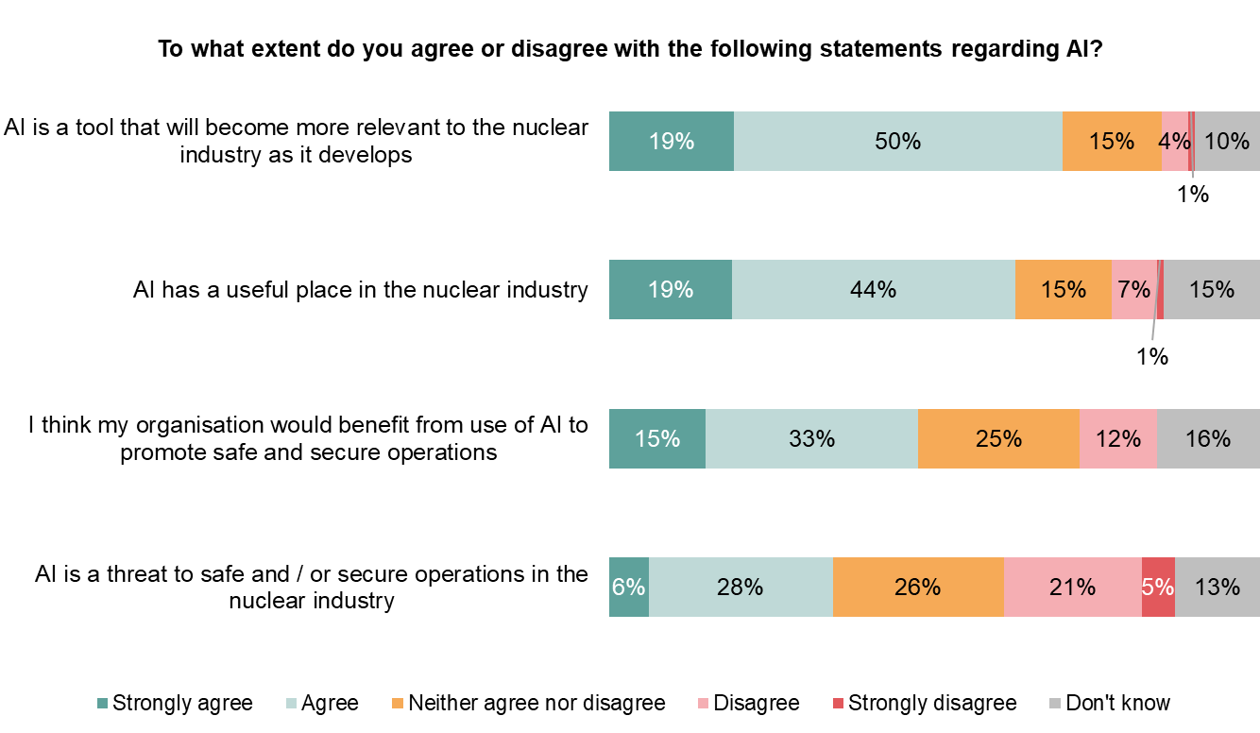
Almost three-quarters of stakeholders believe that AI will be a tool that becomes increasingly relevant to the industry
Reflecting that AI is still an emerging technology, there is less certainty their own organisations will benefit from the use of AI.
NET Agree
NET Disagree
Stakeholders are aware that AI may have been used in their organisations, but generally feel this has been limited to-date, and hold a degree of caution about what AI could be used for.
70%
5%
64%
7%
“I personally haven't, no. No, it’s not something which really crops up. I do know one of my colleagues in my work area has had a little play with it.”
Decommissioning Site
48%
12%
34%
26%
Q16. In your experience working at SITE, to what extent, if at all, do you agree or disagree with the following statements regarding AI in the nuclear industry (n=151)
Have you used Artificial Intelligence (AI) to date (Qual interviews)

Slide 31
AI is seen as a potential useful tool, particularly in supervisory applications with three-quarters (74%) of stakeholders anticipating it would be useful.
However, there is a sense that many are unsure how this would be used in a day-to-day setting, with many stakeholders aware they need time to fully understand AI and consider how it could be useful.
NET Useful
NET
Not Useful
74%
7%
69%
10%
58%
19%
Whilst current use is limited, and for many AI is something of an unknown, there are suggestions that it could be used to identify issues quickly, or to test other innovations provided there is a safe environment to do so.
"you digitally replicate, for example, plant operations and you will carry out the tweaks in digital twinning to apply out on the plant.“
Decommissioning Site
“…you come back to that bit about AI, you can only use it in areas. So, an area that they are starting to think about using it in, is you use a drone to look at a building and it flags up areas for greater attention. Areas that you could do more work on and decide whether it was. So, they help you make a decision.”
Decommissioning Site
Q17: To what extent do you feel AI would be useful in the following areas of work? (n=151)

Slide 32
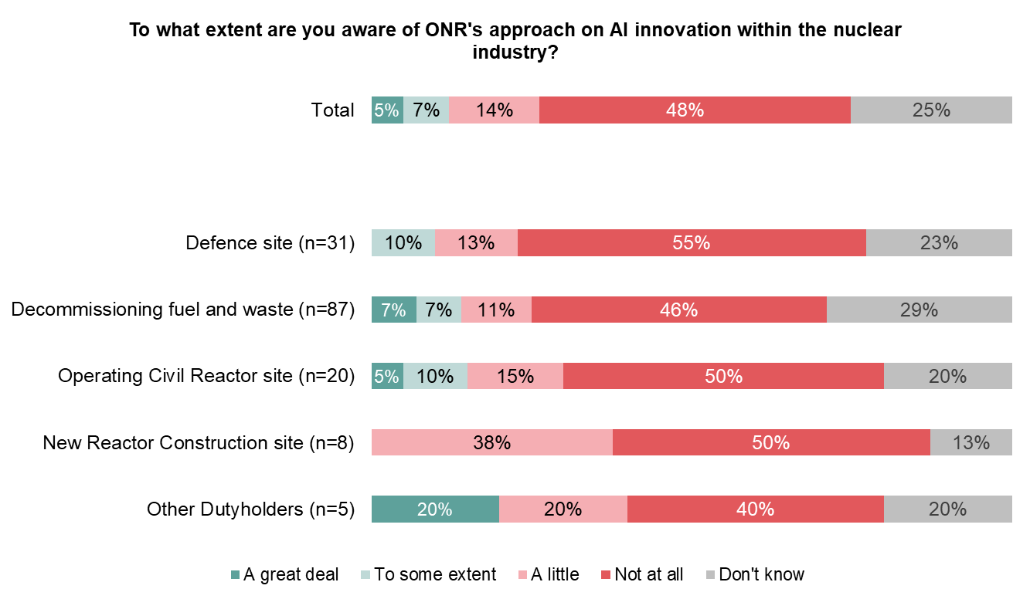
However, there is a lot of uncertainty about AI and ONR’s attitude towards it, with almost half of stakeholders (48%) unaware of ONRs approach
This lack of knowledge of ONR’s attitude towards AI is consistent amongst all types of sites and across job-levels. Those who have inquired about innovation are more likely to say they aware to at least some extent but it is still under a quarter of this group who are aware (23%).
NET AWARE
to some extent
Aware of ONR approach to AI to some extent - by level
13%
Director level
15%
10%
14%
Manager / Supervisor
7%
15%
0%
Junior operative 33%
20%
Q18. To what extent are you aware of ONR's approach on AI innovation within the nuclear industry? (n=151)

Slide 33
Reflecting this uncertainty many stakeholders were unclear what ONR’s attitude to AI was
Stakeholders often assumed that ONR would have a clear position on the use of AI but felt unable to offer any suggestions as to what that would be. Some did believe that based on other conversations that they have had with ONR that they would be receptive to AI as a new technology and would be keen to work with sites to implement potential AI solutions.
“Well, I couldn't give a definitive answer to the question, but I would be surprised if they're not exploring it to see what their role could be in implementing it, if there is a place for it.”
Decommissioning site
"I don't think they'd be averse to it for decommissioning. I think for obviously nuclear generation and stuff like that, I think that would be very hard to justify."
Decommissioning site
“I guess what I'm saying is that the fact that they're so open to new approaches, I would very much assume they would be open to AI approaches."
Defence site
“Probably has but I don't know it.”
Decommissioning site
The fact that the nuclear industry is often considered to be a conservative industry means that with AI there were often particularly strong concerns about how it is managed safely at sites with active nuclear materials, either Defence sites or Operating Civil Reactor sites. Those working in these environments placed an emphasis on ONR ensuring that AI is implemented in a safe manner.
“I think it depends on what circumstance and in what environment, so if we're talking about computers calculating different scenarios […] then there may be an appetite for it if there's a way of checking and making sure that it all works. But I think there would be a reticence about it in the nuclear industry because of the security connotations associated with it.”
Defence site
“I think there is a place for it, I think we just have to be really careful, because from a security perspective, making sure that we don't use it in inappropriate ways or give it information that can then be used by outside organisations, so I think it's something that we'll have to be very careful about we use and integrate it.”
Operating Civil Reactor Site
“I would hope they're up to speed on AI and that type of thing, because obviously, a lot of that can have effects on security on a site too.”
Defence site
Do you think ONR has a position on the use of AI in the nuclear industry (Qual interviews)
How prepared do you think ONR are for potential increased use of AI in nuclear operations(Qual interviews)

Slide 34
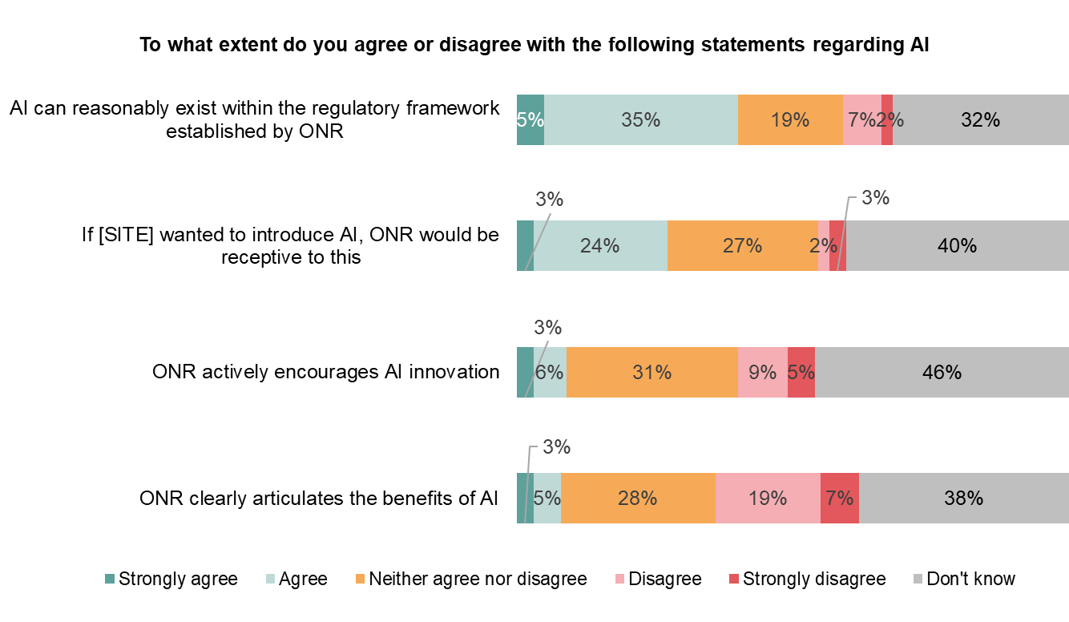
As a result, only one in ten stakeholders feel ONR either actively encourage the use of AI, or clearly articulate the benefits of AI
There are high levels of uncertainty about ONR’s attitudes towards AI, but stakeholders generally believe that ONR can or will establish a regulatory framework that supports AI or would be receptive to it. However, they still feel ONR are more reactive than proactive in supporting innovation.
NET Agree
NET Disagree
40%
9%
“No, we wouldn’t use AI until there was some kind of regulatory guidance.”
Operating Civil Reactor Site
27%
5%
9%
14%
8%
26%
Q19. To what extent, if at all, do you agree or disagree with the following statements regarding ONR and AI innovation: (n=151)

Slide 35
Proportionality and ONR

Slide 36
Summary: Proportionality and ONR
Almost three-quarters (72%) of stakeholders agree that ONR act in a way that is proportionate, and this is something that is consistent across sites and the levels at which people work.
When discussed in depth with stakeholders, there can be a sense that there are different experiences that can impact their perception over the extent to which ONR are proportionate.
Overall four in five stakeholders (80%) agree that ONR consider how far a duty holder has fallen short of regulations when implementing safety and security guidance, whilst three-quarters (75%) agree that ONR’s enforcement actions are proportionate to the severity of the breaches they address.
Ensuring that ONR maintain a two-way dialogue with stakeholders is seen as the most important way to ensure that ONR are proportionate in the way they approach regulation.
"I've seen a lot more in the last 2 or 3 years that proportionality has really started to become more prominent.”
Defence site
“It's an exceptionally homogeneous group. So, they are subject to group think, and they struggle to see the perspective of a duty holder.
Operating Civil Reactor Site
"I think it's keeping up with that good relationship, that talking and, sort of, working with us to try and improve things.”
Decommissioning site

Slide 37
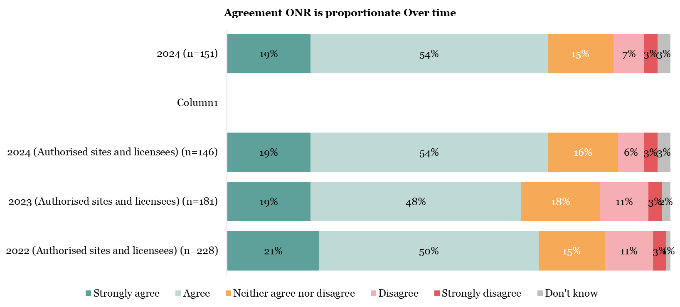
There has been a small increase in stakeholders saying they agree that ONR operates in a way that is proportionate, up five percentage points since 2023
Overall this is broadly in line with results from 2022 and 2023, suggesting that ONR is generally seen as proportionate, with more than two-thirds of stakeholders agreeing with this statement.
NET Agree
NET Disagree
72%
9%
73%
9%
67%
14%
71%
13%
Q20. To what extent, if at all, do you agree or disagree that ONR operates in way that is proportionate?

Slide 38
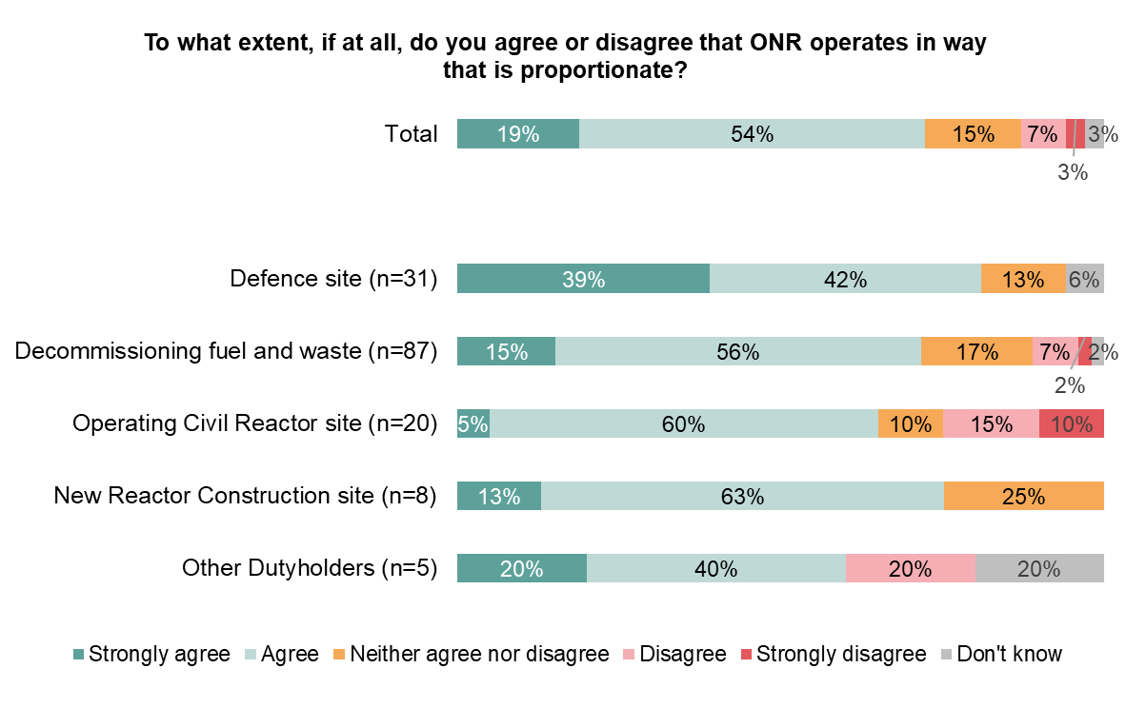
The majority of stakeholders feel that ONR are proportionate in the way they operate, this is consistent across all types of sites
Defence sites were particularly likely to strongly agree that ONR are proportionate, with two in five (39%) strongly agreeing ONR are proportionate, whilst none disagree at all.
NET:
Agree
NET:
Disagree
Agree ONR operates proportionally - By level
72%
9%
Director level
75%
81%
0%
Manager / Supervisor
72%
71%
9%
65%
25%
75%
0%
Junior operative 83%
60%
20%
Q20. To what extent, if at all, do you agree or disagree that ONR operates in way that is proportionate? (n=151)

Slide 39
When explored, stakeholders generally feel that ONR and inspectors tend act as a guide and help support sites in adhering to regulations
Stakeholders comment on early advice and guidance from inspectors about what they need to do to prevent regulatory interventions. This is something that stakeholders think has developed over time.
“If I raise something like that, it's more an advisory, 'Look, this is not a major issue now, but if it's not addressed it will be,' type of thing...Again, I find the ONR to be quite measured so yes, I think they do.”
Decommissioning site
"I've seen a lot more in the last 2 or 3 years that proportionality has really started to become more prominent.”
Defence site
“I think when you talk to them, when you talk to the site inspector, […] and others, they're quite open."
Operating Civil Reactor Site
"Most of the time I find the ONR inspectors to be very proportionate and sensible in their approach. Every now and then we can find ourselves getting to a position where proportionality seems to go out of the window. And that's a bit about sometimes we're asked to update paperwork and things like that which has no net benefit for safety but does make it easier for a regulator or others to go back and check.”
Defence site
However, there are some more negative examples where stakeholders feel that ONR has not shown proportionality, either in one particular area they experience or more generally.
“[Yes ] On day to day running, stuff like that. As I say, I don't think security do, I have to say I think security is over the top.”
Decommissioning site
“Some individuals are entirely sensible and, you know, its simply a pleasure to talk to them because they understand what you're saying, they listen, and they respond accordingly. Other inspectors are incredibly belligerent, and they show no sign of proportionality at all so I'm afraid it's a complete spectrum.”
Decommissioning Site
“It's an exceptionally homogeneous group. So, they are subject to group think, and they struggle to see the perspective of a duty holder. Given that none of them to my knowledge bar 1 has ever worked for a duty holder. They have little to no appreciation of what it is we're trying to achieve and how we're trying to do that.”
Operating Civil Reactor Site
In terms of the way the ONR operates, do you think it responds to issues in a way that is proportionate (Qual interviews)
Have you interacted with Inspectors and if so do you feel they have been proportionate? (Qual interviews)

Slide 40
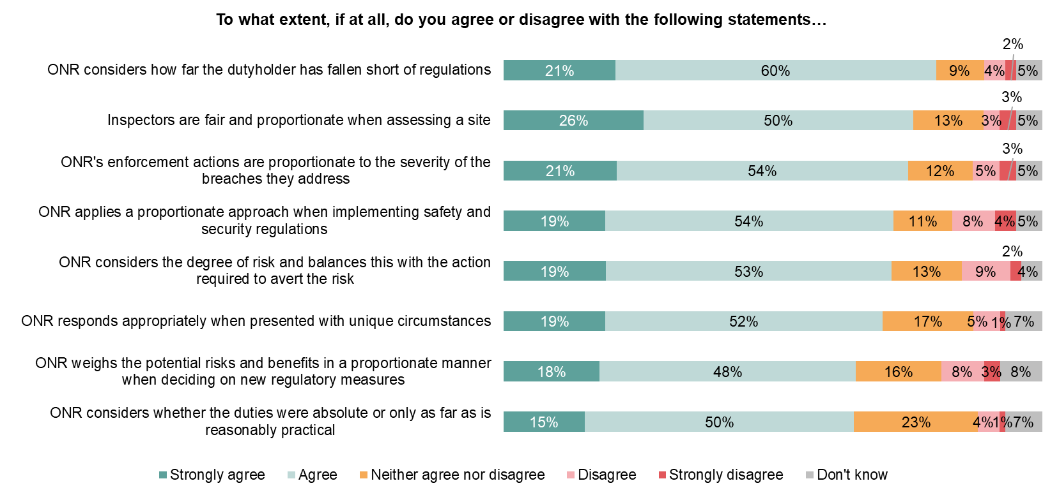
Stakeholders feel that ONR are broadly proportionate, particularly in relation to how far the dutyholder has fallen short of regulations
Overall, there are low levels of disagreement that ONR is proportionate, with most stakeholders feeling that ONR do operate in ways that consider the particular circumstances of sites and potential breaches of regulations.
NET Agree
NET Disagree
80%
6%
76%
5%
75%
8%
73%
12%
72%
11%
71%
6%
66%
11%
66%
5%
Q21. And to what extent, if at all, do you agree or disagree with the following statements about ONR's approach to proportionality? (n=151)

Slide 41
Maintaining good proactive two-way communication is seen as important for stakeholders to continue working effectively with ONR
Stakeholders appreciate where ONR communicate clearly and regularly with them, and want ONR to continue and expand two-way communication. For some stakeholders in particular this could include further efforts to proactively share new approaches and guidance rather than being reactive and waiting for licensees to approach ONR.
"I think it's keeping up with that good relationship, that talking and, sort of, working with us to try and improve things. That's what I would say, yes. Communication I think.”
Decommissioning site
“They've always been very positive and supportive so I think in terms of improvement I wouldn't really be able to comment but certainly in terms continuing what they're doing, I'm certainly a big advocate of that.”
Decommissioning Site
“ONR need to spend a lot more time understanding what the business is saying. Because at the end of the day the business actually does the job."
Decommissioning Site
“Knowledge sharing should be there, it should be better than it is. ONR is a smaller group, so they should be able to share internally anything that's coming up and then pass it out wider to the various sites."
Decommissioning site
"The only thing that I think we could do better at is, you know, the ONR using their breadth of vision to give us any insights from around the nuclear industry."
Operating Civil Reactor Site
“Making it more of a collaborative experience."
Operating Civil Reactor Site
Other suggestions for how ONR could act more proportionally and effectively in the future include listening to the sites to understand different challenges that different sites may have so that there is not a one-size fits all approach to regulation.
"I think that would be it, to see the bigger picture, and an example would be the balance of risk, risk appetite because I think they're slightly different things, but they're examples of where I might encourage ONR to do something there.”
Decommissioning site
"Work on what proportionate means so the people who are applying the rules, so it's the detailed assessors and site inspectors rather than just at the top. So, help them through it to help the licensee.”
Decommissioning Site
When regulating, do you think ONR take into account particular circumstances in their enforcement actions? (Qual interviews)
what one piece of advice would you give to ONR to help sustain and improve its overall performance in future? (Qual interviews)

Slide 42
Conclusions and recommendations

Slide 43
ONR are supportive of innovation but could be more active in promoting innovation
When stakeholders do contact ONR to enquire about innovation, stakeholders find them open and supportive.
They most often contact ONR via their existing contacts, such as site inspectors, trusting them to point them in the right direction.
However there is a sense that ONR wait for sites to be innovative, rather than being proactive and sharing examples of good innovative practices that could be applied.
There is particularly high uncertainty relating to AI with the majority of stakeholders still unsure of how to use AI and ONR’s position on it.
ONR are seen to be generally proportionate and considerate in their regulation and enforcement. Stakeholders recognise that ONR support safety, however some feel that ONR could work further on balancing risk to be more proportionate in their response to particular enforcement actions or regulations.
Areas where ONR can improve in the future
Being proactive and knowledge sharing
Developing and outlining an AI strategy
Maintaining conversations
There is a notable gap between stakeholders who have contacted ONR to enquire about innovation and those who have not. Even amongst those who have there is the suggestion that ONR leading on innovation, and actively sharing experience would help embed innovative thinking further across the industry.
AI is noted to be in its infancy and there is a lot of unknowns amongst stakeholders. ONR could support this by outlining a strategy and making it clear where AI could be utilised at low risk to support sites in being more efficient and safer. Guidance is felt to be needed so sites can invest in AI with confidence that it would be a worthwhile endeavour.
ONR is generally noted to be strong at working with stakeholders, engaging at an early stage and acting as a “critical friend” prior to being involved as a formal regulator. This is an area of importance for sites who seek an understanding of how ONR may react prior to their investing time and money into a new procedure or innovation.

Slide 44
Contact us
Email: hello@savanta.com
Tel: +44 (0) 20 7632 3434

